Slide 1
ASP.NET
Module-14
Introduction to Web Application

Slide 2
Objectives
Introduction to ASP.NET
  Concepts and Architecture
  ASP.NET Features
  Advanced ASP.NET
ASP.NET and the Microsoft® .NET Framework

Slide 3
Web
Web is basically client server with a twist
The client (browser) is good graphic representation but has almost no processing power (only renders HTML)
The server has most of processing power.
Stateless by default remembers no detail about a client and what they have done

Slide 4
Web Programming
Web Programming is not like traditional programming
The main difference revolves around where things are done:
The Web base Application:
  Input is collected on client
  Input sent to server in terms of request
  Server process the request
  Server sent back response for request
  Output display at client
Example: Web base calculator

Slide 5
Web Architecture
Web is basically client/server with a twist. Submitting (sending) a form to the server for processing.
Response: Server sending back a request page to the client (browser).
Round Trip: Request from client and response from server.

Slide 6

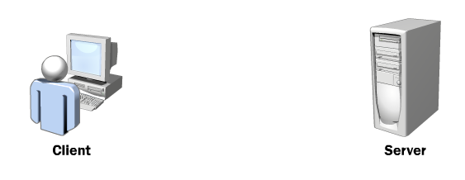

Client-Side and Server-Side Events

Slide 7
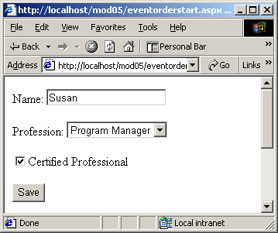
Action in response to a user’s interaction with the controls on the page

Slide 8
Terms
Request: Client request a page from the server or client posts page back to server.
Post: Submitting (sending) a form to the server for processing.
Response: Server sending back a request page to the client (browser).
Round Trip: Request from client and response from server.

Slide 9
Contents
Section 1: Overview
Section 2: Architecture
  Microsoft .NET Framework and ASP.NET Configuration
Section 3: ASP.NET Features
  State Management, Security, and Event Model
Section 4: Advanced ASP.NET
  Web Forms and Web Services
  Working with Data
  ASP to ASP.NET Migration

Slide 10
Section 1: Overview
“Looking Back ...“
ASP.NET Core Concepts

Slide 11
Looking Back: Active Server Pages
What is ASP?
  Server-side scripting technology
  Files containing HTML and scripting code
  Access via HTTP requests
  Scripting code is interpreted on server side
What can I do with ASP?
  Easily and quickly create simple Web applications
  Generate dynamic Web content
  Client-side scripting for validation
  Access COM components to extend functionality
    Databases

Slide 12
What’s Wrong with That?
Mixes layout (HTML) and logic (scripting code)
Interpreting ASP code leads to performance loss
Uses scripting languages that are not strongly typed
  Microsoft JScript®
  Microsoft Visual Basic® Scripting Edition (VBScript)
Browser compatibility
No real state management
  No state sharing across Web farms
  State is lost when IIS fails
Update files only when server is down

Slide 13
ASP.NET Core Concepts
Web development platform
New programming model
Web Client
IIS
ASP.NET
Applications
.NET
Framework
Operating System

Slide 14
ASP.NET Core Concepts
Separate layout and business logic
Use services provided by the .NET Framework
Code is compiled the first time a page is requested
State management
Make use of programming languages
  Cross-language integration
Update files while the server is running!

Slide 15
Section 2: Architecture
The .NET Framework Architecture
Web Application Model
Configuration
Class Hierarchy

Slide 16









What is the .NET Framework?
Developer Tools
Clients
ASP.NET Web Applications
Databases
XML Web Services
User Experiences
.NET Framework

Slide 17
The .NET Framework Architecture
Microsoft .NET Framework
ASP.NET
Windows Forms
Web Forms
Web Services
Services Framework
Base
Data
Debug
...
Common Language Runtime
System Services

Slide 18

Visual Studio .NET: The Tool for .NET Development
Web Forms Tools
Windows Forms Tools
Multiple Languages
Visual Studio .NET
Error Handling
Web Services Tools
Data Access
Design
Develop
Debug
Deploy

Slide 19
Web Application Model
Unmanaged Code
HTTP Request
Host (IIS, Internet Explorer)
HTTP Runtime
Managed Code
HTTP Module
HTTP Module
Request Handler
...

Slide 20
Hierarchical Configuration
Configuration file: Web.Config
  XML-based, human readable and writeable
  File is kept within the application directory
  Changes are automatically detected
Influence on the actual dir and all subs
  But: <location path=“...“>
  Lock settings with attribute: allowOverride=“false“
Root
Dir
Web.Config
Sub
Dir1
Sub
Dir2

Slide 21
Web.Config sample
<configuration>
<configSections>
<sectionGroup name=“system.web“>
<section name=“httpmodules“
type=“System.Web.Configuration.
HttpModulesConfigurationHandler“/>
<section name=“sessionstate“
type=“System.Web.SessionState.
SessionStateSectionHandler“/>
</sectionGroup>
</configSections>
<system.web>
<httpmodules>
<add type=“System.Web.State.SessionStateModule“
name=“Session“>
</httpmodules>
<sessionstate cookieless=“true“ timeout=“20“/>
<system.web>
</configuration>

Slide 22
Custom Configuration
Default machine.config (!) file is placed in
  %windir%\Microsoft.NET\Framework\<version>\CONFIG
  Standard set of configuration section handlers
    Browser capabilities, custom error messages, and so on
Customized configuration
  Extend the set of section handlers with your own
  Implement the interface:
      System.Configuration.IConfigurationSectionHandler
Problems with
  Virtual directories and non-ASP.NET files

Slide 23
Class Hierarchy 1/2
Namespaces
  Hierarchically structured
  Dot-syntax, grouping classes logically
  Abstract base classes and class implementations
    You are free to implement your own
  Sample: System.Web.UI.WebControls.Button
  namespace class name
  How to use namespaces:
    using MyAlias = System.Web.UI.WebControls

Slide 24
Class Hierarchy 2/2
System.Object
System.Web.UI.Control
System.Web.UI.
WebControls
WebControl
ListControl
Table
ListBox
Button
CheckBoxList
TextBox
...
...

Slide 25
Section 3: Features
ASP.NET Syntax and Supported Languages
  Samples
Execution Process
Assemblies
State Management, Security, and Event Handling

Slide 26
Business Logic and Layout
No more blending of HTML and scripting code
  Easy maintainability of your application
Completely separate layout and processing logic
  No implementation code within HTML files
  Files for designers and files for programmers
  You can still mix HTML and scripting code if you wish
.cs
.aspx.cs
.aspx

Slide 27
Supported Languages
Visual Basic
  VBScript is unmanaged !
JScript
C#
  New component-based language
C++
  Managed Extensions for C++
Others: Cobol, Smalltalk, ...
  Common Language Specification (CLS)

Slide 28
C# Overview
New component-oriented language from Microsoft
  Evolution of C and C++
  Introduces improvement in areas such as
    Type safety, versioning, events and garbage collection
  Provides access to APIs like .NET, COM, or Automation
“Hello World” sample
using System;
namespace hwsample
{
public class Hello {
public static void Main() {
Console.WriteLine(“Hello World!“);
}
}
}

Slide 29
QuickStart
Different files with different file name extensions
  Standard ASP.NET files: .aspx or .ascx
  Web Services: .asmx
  Code (behind) files: .aspx.cs, .asmx.vb, ...
  Configuration: Web.Config
  Web applications: Global.asax and Global.asax.vb
All of them are text files
The easiest way to start
  Change the .asp extension to .aspx

Slide 30
Page Syntax 1/3
Directives
  <%@ Page language=“VB“ […] %>
Code Declaration Blocks
  <script runat=“server“ […]>
  [ lines of code ]
  </script>
Code Render Blocks
  <%
  [ inline code or expression ]
  %>
HTML Control Syntax
  <HTMLelement runat=“server“ [attribute(s)]>
  </HTMLelement>

Slide 31
Page Syntax 2/3
Custom Control Syntax
  Custom server controls
    <ASP:TextBox id=“MyTb1“ runat=“server“>
  Server control property
    <ASP:TextBox maxlength=“80“ runat=“server“>
  Subproperty
    <ASP:Label font-size=“14“ runat=“server“>
  Server control event binding
    <ASP:Button OnClick=“MyClick“ runat=“server“>

Slide 32
Page Syntax 3/3
Data Binding Expression
  <asp:label
  text=‘<%# databinding expression %>’
  runat=“server” />
Server-side Object Tags
  <object id=“id“ runat=“server“
  identifier=“idName“ />
Server-side Include Directives
  <!-- #include pathtype = filename -->
Server-side Comments
  <%-- comment block --%>

Slide 33
ASP.NET Sample 1/2
<html>
<script language=“VB“ runat=server>
Sub SubmitBtn_Click(Sender As Object, E As EventArgs)
Message.Text = “Hi “ & Name.Text
End Sub
</script>
<body>
<form action=“thisfile.aspx“ method=post runat=server>
<h3> Name: </h3>
<asp:textbox id=“Name“ runat=server/>
<asp:button type=submit text=“LookUp“
OnClick=“SubmitBtn_Click“ runat=server/>
<p>
<asp:label id=“Message“ runat=server/>
</p>
</form>
</body>
</html>

Slide 34
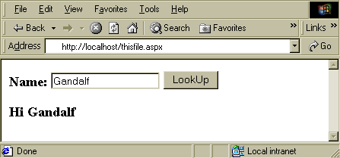
ASP.NET Sample 2/2

Slide 35
.aspx Execution Cycle
Client
Server
IIS
Request .aspx file
ASP.NET Runtime
Code
behind
Parse .aspx file
Generate page class
Instantiate controls
Response

Slide 36
Execution process
Compilation, when page is requested the first time
Microsoft intermediate language (MSIL)
  Assembly language–like style
  CPU independent
  Provides a hardware abstraction layer
  MSIL is executed by the common language runtime
Common language runtime
  Just-in-time (JIT) compiler
  Managed code

Slide 37
Assemblies
Result of compiling is still a .dll or .exe file
  Multiple- or single-file assembly
Assembly 1
Assembly 2
MyApp.dll
pic1.jpg
MyApp.dll
shared name
metadata
metadata

Slide 38
Metadata
An assembly’s manifest
  A manifest contains
    List of all assembly files
    Information about versioning, shared name
    and more ...
  The information is used to
    Locate and load class types
    Lay out object instances in memory
    Resolve method invocations and field references
    Translate MSIL to native code
    Enforce security

Slide 39
State Management 1/2
Application State
  What is an “application”?
    Files, pages, modules, and executable code
    One virtual directory and its subdirectories
  Application state variables
    Global information
  Implementation rules
    Use of system resources
    “Lock” and “unlock” your global information
    Beware of global variables in multithreaded environments
    Loss of state when host is “destroyed”
    No state sharing across Web farms

Slide 40
State Management 2/2
Session State
  What is a session?
    Restricted to a logical application
    Context in which a user communicates with a server
  Functionality
    Request identification and classification
    Store data across multiple requests
    Session events
    Release of session data
  .NET State Server Process

Slide 41
Security 1/3
Reasons for Security
  Prevent access to areas of your Web server
  Record and store secure relevant user data
Security Configuration in Web.Config
  <authorization>, <authentication>, <trust>, ...
Authentication, Authorization, Impersonation
Code Access Security
  Are you the code you told me you are?
  Protect your server from bad code

Slide 42
Security 2/3
Authentication
  Validates user credentials
  Awards an authenticated identity
  Types of authentication
    Windows, integrating with IIS 5.0
    Passport, centralized services provided by Microsoft
    Forms, request attachment
Authorization
  Determine whether request is permitted
  File and URL authorization

Slide 43
Security 3/3
Impersonation
  IIS authenticates the “user”
  A token is passed to the ASP.NET application
  ASP.NET impersonates the given token
  Access is permitted according to NTFS settings
Code Access Security
  .NET Framework feature
  Verify the code‘s identity and where it comes from
  Specify operations the code is allowed to perform

Slide 44
Event Model 1/2
Application-level Event Handling
  Web Forms
Delegate Model
  Connect event sender and event receiver
  Single and multicast delegates
Event Delegates Are Multicast
Event Wiring
  Register event handler with event sender

Slide 45
Event Model 2/2
Events raised on client, but handled on server
event
message
Web Client
Server
event
parse message
call appropriate
event handler
event handler
response

Slide 46
Event Samples
Event samples
  System.Web.UI.WebControls
  Class Button, public instance event Click
  System.Web.UI
  Class Page, public instance event Load
Events in C#
  ASP.NET
  C#
<asp:ImageButton id=btnNext runat=“server“
imageurl=“...“ onclick=“btnNext_Click“/>
protected void btnNext_Click(Object S,
ImageClickEventArgs E)
{
[ ... do something ... ]
}

Slide 47
Section 4: Advanced ASP.NET
Web Forms and Web Services
Server Controls
Working with Data
Web Applications
Migrating from ASP to ASP.NET

Slide 48







ASP.NET Web Application
ASP.NET Web Server
Clients
Web Forms
Page1.
aspx
Web.
config
Code-behind pages
Output Cache
Internet
Page2.
aspx
machine.
config
global.
asax
Web
Services
Database
Components
XML Data

Slide 49
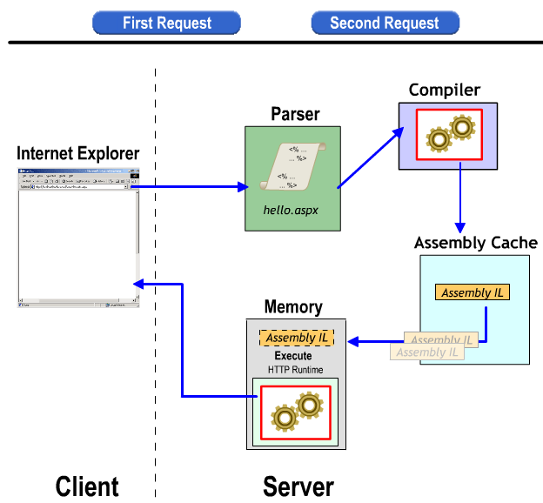
Multimedia: ASP.NET Execution Model

Slide 50
Web Forms Overview 1/2
thisfile.aspx
thisfile.aspx.cs
...
<asp:Button id=“LookUp“
OnClick=„SubmitBtn_Click“ />
...
SubmitBtn_Click() { ...

Slide 51
Web Forms Overview 2/2
Create programmable Web pages
  Use any .NET programming language
  Provides a rich set of server-side controls
  Web Forms event model
Run on any browser
Visual and logic parts of your Web application
System.Web.UI.WebControls namespace

Slide 52
Sample Web Forms
thisfile.aspx.cs:
thisfile.aspx:
private void SubmitBtn_Click(object s, SystemEventArgs e)
{
Message.Text=“Hi “ & Name.Text
}
<%@ Page Language=“C#“ Codebehind=“thisfile.aspx.cs“
... %>
<body>
<form action=“thisfile.aspx“ method=post runat=server>
<h3> Name: <asp:textbox id=“Name“ runat=“server“ />
<asp:button type=submit text=“LookUp“ id=“LookUp“
OnClick=“SubmitBtn_Click“ runat=“server“ />
<br>
<asp:label id=“Message“ runat=“server“ />
</form>
</body>
</html>

Slide 53
Web Services
Black boxes providing specific functionality
Exposed over the Internet
To be consumed by applications independent of
  Operating system
  Programming language
  Component model

Slide 54
Web Services Overview 1/2
For the most part, similar to COM programming
Based on simple, open standards
  XML-based communication
Communication = Messaging
Client and Web Service are “loosely coupled”
URL—the key to Web Services
  http://<serverName>/<VirtualDir>/
  <fileName>/<methodName>?var=value

Slide 55
Web Services Overview 2/2
Web Service Wire Formats
  HTTP: GET and POST
  SOAP
Web Services Description Language (WSDL)
  XML-based
  Abstract description of the Web Service
Transactions
  ASP.NET transactions = COM+ transactions

Slide 56
Sample Web Service
<%@ WebService Language=“C#“ Class=“MyClass“ %>
using System.Web.Services;
public class MyClass : System.Web.Services.WebServices
{
[ WebMethod ]
public int Compute1(int i1, int i2)
{
return i1 + i2;
}
public int Compute2(int i1, int i2)
{
if (i1 > i2) return i1 - i2;
else return i2 - i1;
}
}

Slide 57
Server Controls Overview
Web Forms Server Controls
Server Controls Families
  HTML
  ASP.NET
  Validation
  User
  Mobile
Data Binding
Page Class
  Reunion of code and content

Slide 58
Server Control Families 1/2
HTML Server Controls
  Map directly to HTML elements
  HTML attributes
  Samples: HtmlAnchor (<a>), HtmlTable (<table>)
ASP.NET Server Controls
  Abstract controls
    No one-to-one mapping to HTML server controls
  Typed object model
  Automatic browser detection
  Rich set of controls
  Sample: TextBox (<asp:textbox>)

Slide 59
Server Control Families 2/2
Validation Controls
  Check user input
  Different types of validation
    Required entry
    Comparison, range checking, pattern matching
    User defined
User Controls (Pagelets)
  Partition and reuse UI functionality
  .ascx file name extension
  Object model support
Mobile Controls

Slide 60
Server Controls: Syntax
Focusing ASP.NET Syntax
  <asp:controlName attributes />
  controlName
    TextBox, DropDownList, and so on
  attributes
    Id=controlID
    runat=server

Slide 61
Server Controls Sample
Checkout.aspx:
Checkout.aspx.cs:
<asp:TextBox id=txtAddress runat=server
MaxLength=255>
<asp:RequiredFieldValidator id=RFV1
runat=server ...>
foreach (Ivalidator val in Page.Validators)
{
val.Validate();
}

Slide 62
Working with Data 1/3
SQL and XML
  Access and manipulate data
Managed data access APIs provided by the runtime
Essential Objects
  OleDbConnection, OleDbCommand, and DataSet
Namespaces
  System.Data and System.Data.OleDb

Slide 63
Working with Data 2/3
ADO.NET Overview
  Disconnected data architecture
  Datasets are complete relational views of data
  XML and XML schema
Windows Form
Internet
Web Form
Data Object
XML
B2B
Dataset

Slide 64
Working with Data 3/3
C#:
ASP.NET:
using System.Data;
ShoppingCart.CalculateOrderSummary();
DataRow row = ShoppingCart.OrderSummary.Rows[0];
lblSubTotal.Text = System.String.Format(“{0:C}“,
row[OrderData.SUB_TOTAL_FIELD]);
<table width=“100%“>
<tr><td>
<asp:Label id=lblSubTotal runat=server>
</asp:label>
</td></tr>
</table>

Slide 65
Caching
Enhance performance of your Web application
Output Caching
  Store and retrieve pages or objects
  Page caching
  Fragment caching
Expiration Rules
Cache APIs
  Customize caching principles

Slide 66
Web Applications
ASP.NET defines a Web application as the
  “sum of all files, pages, handlers, modules, and executable code that can be invoked or run in the scope of a given virtual directory on a web application server”
Distributed Applications
Presentation
Middle Tier
Database
Web Form
Internet
Web Service

Slide 67
ASP to ASP.NET Migration
ASP and ASP.NET can coexist on the same server
Make use of ASP.NET features
To migrate, ASP files must be modified
  „Migration Wizard“ generates codebehind
    „Add existing item“ and „Rename“
Performance
  Managed vs. unmanaged code
  Early vs. late binding

Slide 68
Migration Issues
Structure
  Code blocks and directives
Security
  ASP.NET security was described earlier
Languages
  C#, Visual Basic.NET
Data Access
  ADO to ADO.NET

Slide 69
Events
Just like .Net programming for Windows web development in .Net uses events
Categories of Events:
  Application level Event
  Page level Event
  Control level Event

Slide 70
Application level Events
Handle Global.asax file (Server side appn)
First Request
  Application_Start
First Request for each user
  Session_Start
Each Request
  Application_BeginRequest
  Application_Authenticate
  Application_EndRequest

Slide 71
Application level Events
Application Error
  Application_Error
User log in/ Session start by browser
  Session_Start
User log out/ Session time out
  Session_End
Web Server Shutdown
  Application_End
Example: (create website)

Slide 72
Page level Events
Abort Transaction: (inherited from template control) which occurs when a user abort transaction.
Commit Transaction: (inherited from template control) which occurs when a user transaction completed
Data Binding: (inherited from control) which occurs when the server control binds to data source.
Example: ( will see in next section)

Slide 73
Page level Events
Error: Occurs when an unhandled exception is thrown
Init: Occurs when the server control is initiate, which is the first step in its life cycle.
Load: Occurs when the server control is loaded into the page object
UnLoad: Occurs when the server control is unloaded from the page object
Disposed: Occurs when server control is release from memory , which is last stage of server control life cycle.

Slide 74
Control level Events
Basically two types:
  Action Event (Do immediate post back).
  Change Event (Cached and reported when the page is PostBack)
Hierarchy : Page Load --> (Control -->
(i) Change (ii) Action)--> Application
Page level Events

Slide 75
Summary
Now you have been introduced to ASP.NET
  Configuration
  Web Forms and Web Services
  Security
  State Management
  Accessing Data
  Web Applications
  Migration

